Slide 1
Scavenger Hunt Game Application
A multiplayer platform that integrates Google Maps API for user device tracking and game play progression
We demonstrate some of the functionalities created with the Google Maps API in video screenshots

Slide 2
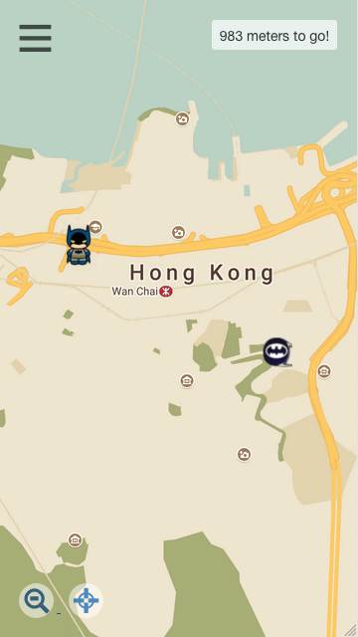
Geolocation
Location of devise
constantly updated
(no matter where you manually drag the user, its true location is still determined by geolocation)
Distance from destination
Automatically updated

Slide 3
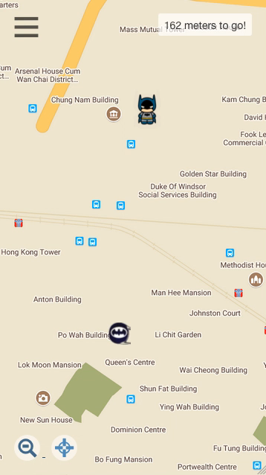
Destination pointer
Appears when destination is out of view
Auto-adjusts relative to user and destination

Slide 4
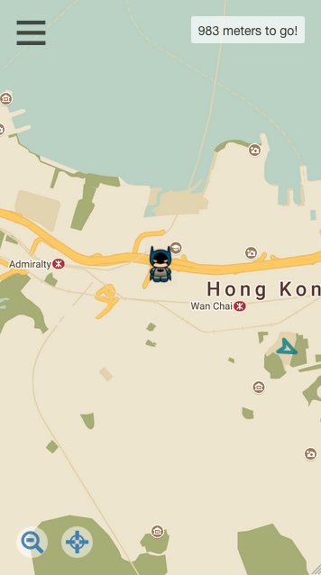
Bird’s-eye view
Zoom out to see both user and destination

Slide 5
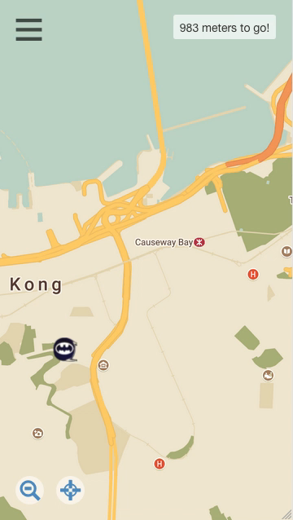
Find and center user
Pan back to the user’s location in case user loses track of where they are

